Slide 1
Population and Sustainable Development
Andrew Mason
East-West Center
July 21, 2021

Slide 2
Acknowledgements
UN Population Division
Most authoritative source of information on population estimates and projections
Collaboration in the development of National Transfer Accounts.
UN Population Fund
Support for construction and use of National Transfer Accounts by regional offices.
Support in the application of NTA
Research teams from over 70 countries who are members of the NTA Network
National Institute on Aging, Hewlett Foundation, International Development Research Centre, European Commission, World Bank, Asian Development Bank, Rockefeller Foundation, and governments and institutions that have supported regional and country-specific work.

Slide 3
Population and sustainable development Highlights
Four ways population influences sustainable development
Gains in life expectancy
Population-driven GDP growth
Transformation of reproduction and human capital investment
Demographic dividends
Policy in an aging world

Slide 4
Gains in life expectancy
Life expectancy at birth
 | India | Japan | US
1900 | 24.0 | 44.0 | 47.0
1950 | 37.9 | 62.2 | 68.6
2000 | 62.5 | 81.8 | 77.2
2020 | 69.9 | 84.8 | 78.9
Source: Maddison (2000) and United Nations (2011, 2019)
Notes: 2020 values projected.

Slide 5
Population as a driver of GDP growth
Given labor productivity (GDP per effective worker), GDP growth is driven by growth in the number of effective workers.
Effective workers uses National Transfer Accounts data for 185 countries to incorporate age-specific variation in labor force participation, unemployment, hours worked, and wages.
Until recently, effective labor grew in countries with both high and low labor productivity contributing to record growth in GDP.
Now, effective labor is growing in countries with relatively low labor productivity, but declining in countries with high labor productivity.
Hence, the contribution of population to GDP growth will be very small in coming decades.

Slide 6
Population as a driver of global GDP Major role in 1975-2000 to minor role in 2020-60
Weighted effective labor is effective labor weighted for country differences in GDP/L in the base year.
Productivity growth is growth of GDP per effective worker.
Based on NTA estimates of labor income and UN estimates and projections of population for 185 countries.
Source: Mason et al (2021)

Slide 7
Transformed reproduction and human capital investment
Increased opportunities for women as they redirect their time to:
Education
Production of market goods and services
Time-intensive childrearing
Small families are investing more per child in human capital
Health
Education
Both public and private

Slide 8
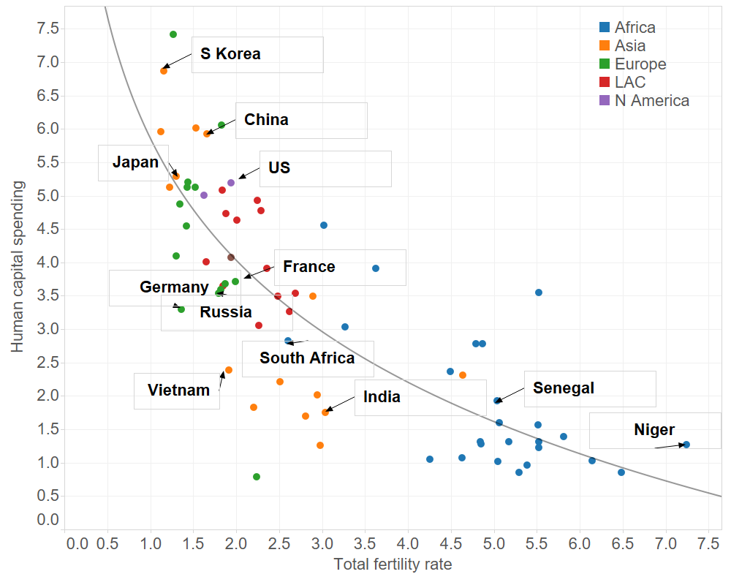
Greater investment in human capital per child
Human capital spending is a synthetic cohort value calculated as the sum of public and private education spending, ages 3 to 26, and public and private health spending 0 to 17 expressed as a percentage of annual pre-tax labor income of persons 30-49.
Higher productivity and income for children
Ability to maintain support for older generations as population aging occurs.
Source: Lee and Mason 2010 updated.

Slide 9
Demographic dividends: Impact of changing population on growth in standards of living.
First dividend
Definition: Growth in the effective number of workers relative to effective number of consumers.
Measurement: Age profiles of consumption and labor income combined with population data to incorporate the effects of policies and practice that vary from country to country.
Second dividend
Definition: Growth in consumption per effective worker due to population change.
Capital deepening, human capital investment, etc.
Not explored here.

Slide 10
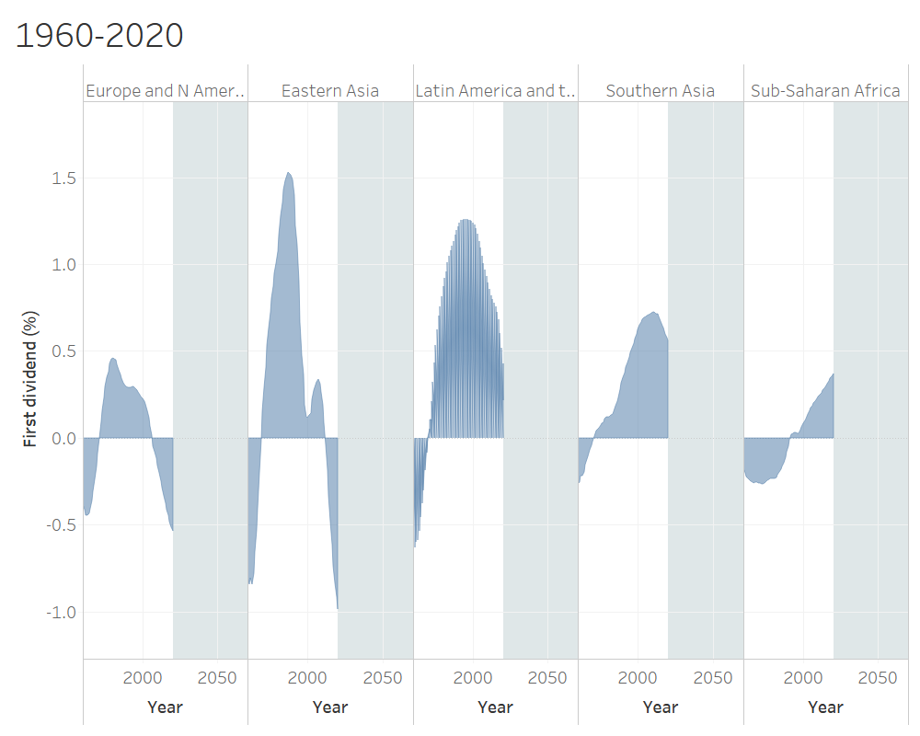
First demographic dividend has contributed to higher standards of living around the world
Largest gain realized in Eastern Asia and Latin America and the Caribbean.
Gains have been delayed and relatively small in sub-Saharan Africa.

Slide 11
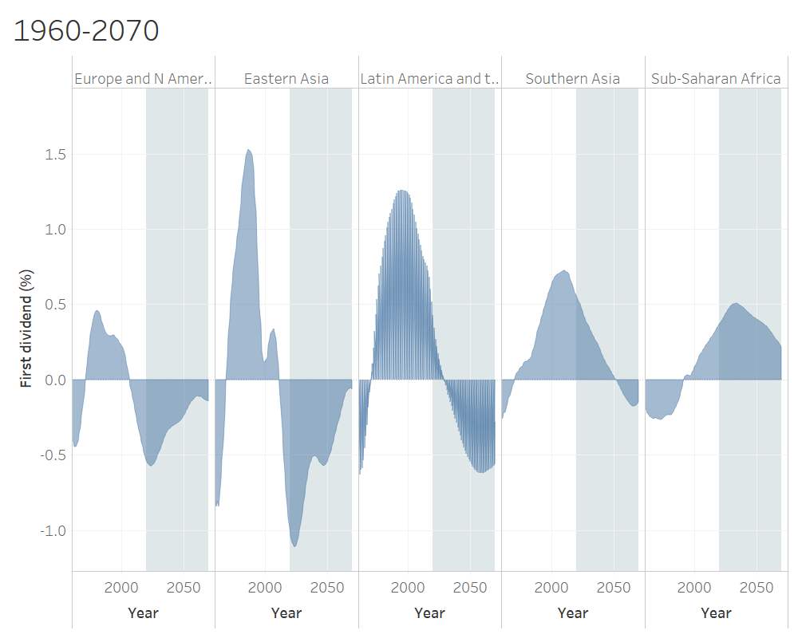
For the next 50 years, the contribution of the first dividend will be very mixed
First dividend has turned negative in the West and in Eastern Asia.
It will turn negative in Latin America and the Caribbean beginning in 2030.
First dividend will be positive in Southern Asia until 2050 and for the foreseeable future in sub-Saharan Africa.
First dividend is playing a convergent role as the support ratio declines in rich countries and increases in poor countries.

Slide 12
Policy in an Aging World
Strategies for increasing resources
Quantity of labor (delayed retirement; gender equity)
Greater investment in human capital
Improvements in capital and labor markets
Cost-reducing innovation (health care)
Reform of reallocation systems
Transfer systems
Asset-based systems

Slide 13
Steady-state transfer system
Old-age needs are often met through intergenerational transfers – public programs in particular.
With aging, per capita transfer outflows (taxes) much rise and/or public transfer inflows (pension and health care benefits) must fall.
Existing transfer systems are not sustainable. In the US, people would have to reduce their consumption by about 30 percent at all ages to achieve sustainable transfer systems.
Lower fertility and slower population growth would have even larger effects.
Note: Current US mortality and age profiles of consumption and labor income, Mason 2021 forthcoming.

Slide 14
Steady-state asset-based system
If people are living longer and relying on an asset-based reallocation system, they must work more and/or consume less to fund greater old-age needs.
Changes in age structure that arise due to fertility decline do not affect lifecycle budgeting at the individual level, except for the possible effects of reduced childrearing costs.
Population aging could affect rates of return to capital leading to lower interest rates.
If so, aging will require higher saving and lower consumption.
Note: Current US mortality and age profiles of consumption and labor income, Mason 2021 forthcoming.

Slide 15
Concluding observations
Population changes have complex implications for sustainable development.
Longer life and modern reproduction contribute in a very positive way.
Population aging will require restructuring of economic systems to achieve sustainable development.

Slide 16
Sources:
Lee R & Mason A (2010) Fertility, Human Capital, and Economic Growth over the Demographic Transition. European Journal of Population 26(2):159-182.
Lee, R. and A. Mason, principal authors and editors. 2011. Population Aging and the Generational Economy: A Global Perspective. Cheltenham, UK: Edward Elgar.
Andrew Mason, 2021 forthcoming, National Transfer Accounts and the Economics of Aging, Bloom et al., Handbook on the Economics of Aging.
United Nations Population Division. 2013. National Transfer Accounts Manual: Measuring and Analysing the Generational Economy. New York: United Nations.
—. 2019. World Population Prospects: The 2019 Revision. New York: United Nations.

